Slide 1
Winning Edge
Technology Review
Peter Sushko, Dylan Heino, John Tatka, Victor Tian, Eric Gibson

Slide 2
Background
WinningEdge™ is a strategy optimization tool for online, low-stakes texas hold’em players.
The application will provide real time probabilities and suggest action based on an ML algorithm trained using historical data.

Slide 3

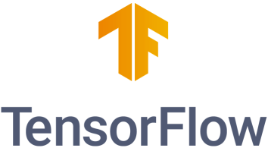

Technologies Considered
PyTorch
Contains many pre-trained models
Simple and transparent processing
Very new and not well documented, not beginner friendly
TensorFlow
Useful for reinforcement learning
Very large community and support
Runs dramatically slower than other ML packages and algorithms
Scikit-learn
Simple, easy-to-use, effective
Extremely wide range of algorithms
Made for simpler data analysis
Not suited for deep learning
Notes:
The main technology we want to implement is machine learning that is trained using the dataset of poker hands purchased from an online 1v1 poker website.
When looking through some ml packages, we settled on three options, PyTorch, TensorFlow, and SciKit-Learn:
Some pros of pytorch is that it contains many pre-trained models and has simple and transparent processing.

Slide 4
Our Choice
Simplicity and Efficiency: Scikit-learn provides a simple and easy-to-understand interface for building and evaluating machine learning models. It’s suitable for simpler tasks without added complexity. Scikit-learn is also more computationally efficient.
Feature Extraction and Selection: Scikit-learn has tools for feature extraction and selection, which can be crucial for identifying relevant features in poker hands. It can help processing categorical data and focus on the most relevant aspects of the input that contribute to the task at hand.
Notes:
In summary, while TensorFlow and PyTorch are powerful for deep learning tasks, scikit-learn's simplicity and efficiency make it a compelling choice for traditional machine learning tasks like analyzing poker hands, especially if the complexity of deep learning is not necessary for this specific problem.

Slide 5
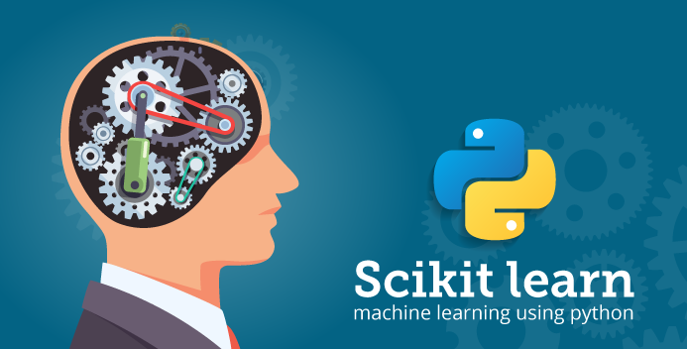
Appeal
Beginning friendly
Simplicity, efficiency, compatibility
Support for predictive analysis
Well-documented, plenty of examples
Seamless integration with other Python packages (e.g. NumPy, SciPy, Matplotlib)
Notes:
Eric’s slide

Slide 6
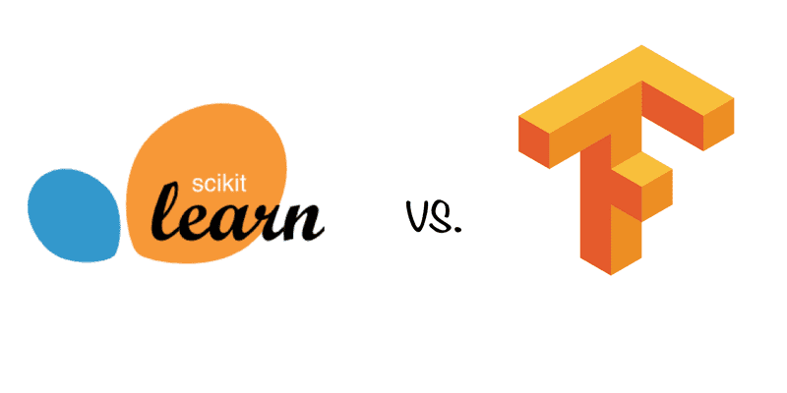
Drawbacks
Limited deep learning support
Less flexibility for model customization
Not ideal for extremely large datasets and high-performance model training

